Slide 1
Mounting a BalanceBox®400 to a brick wall
Unpack the BalanceBox®400 and remove the Wall frame cover and its bag of screws. Slide the cover out at the top.
NOTE: the cover is NOT included with the BalanceBox®400H

Slide 2
Mounting a BalanceBox®400 to a brick wall
Unpack the BalanceBox®400
Take the wall bracket out of the box
Note the slotted/slanted holes for level wall mounting.
Round holes for locking and mobile stand / floor support mounting.

Slide 3
Mounting a BalanceBox®400 to a brick wall
Hole for mobile stand
Use the indicated hole for mounting on the Mobile stand

Slide 4
Mounting a BalanceBox®400 to a brick wall
~1700 to 1800 mm
from the floor
Measure the mounting height from the floor.
And mark it

Slide 5
Mounting a BalanceBox®400 to a brick wall
Using a level, mark the horizontal position of the other hole level to the first hole.
(distance 406mm / 16”)

Slide 6
Mounting a BalanceBox®400 to a brick wall
Mark the position of both holes at a distance of 406mm /16”

Slide 7
Mounting a BalanceBox®400 to a brick wall
406mm/ 16”
Mark the position of both holes at a distance of 406mm /16”

Slide 8


Mounting a BalanceBox®400 to a brick wall
Drill the holes in the brick wall, use a 10 mm drill for plastic plugs and 8mm diameter screws, or appropriate drill for other type wall anchors.

Slide 9
Mounting a BalanceBox®400 to a brick wall
Drill the holes in the brick wall, use a 10 mm drill for plastic plugs and 8mm diameter screws, or appropriate drill for other type wall anchors.

Slide 10
Mounting a BalanceBox®400 to a brick wall
Insert the plug or wall anchor.
Mounting hardware used depends on the type of wall.
Hardware is not included.

Slide 11
Mounting a BalanceBox®400 to a brick wall
Now mount the BalanceBox® wall bracket using the diagonal slotted holes.
Do not tighten fully

Slide 12
Mounting a BalanceBox®400 to a brick wall
Now mount the BalanceBox® wall bracket using the diagonal slotted holes.
Do not tighten fully

Slide 13
Mounting a BalanceBox®400 to a brick wall
Level the wall bracket
And tighten both screws

Slide 14
Mounting a BalanceBox®400 to a brick wall
Level the wall bracket
And tighten both screws

Slide 15
Mounting a BalanceBox®400 to a brick wall
Level the wall bracket
And tighten both screws

Slide 16
Mounting a BalanceBox®400 to a brick wall
Lift the BalanceBox® onto the hooks of the wall bracket

Slide 17
Mounting a BalanceBox®400 to a brick wall
Lift the BalanceBox® onto the hooks of the wall bracket

Slide 18
Mounting a BalanceBox®400 to a brick wall
Lift the BalanceBox® onto the hooks of the wall bracket

Slide 19
Mounting a BalanceBox®400 to a brick wall
Tighten the lock screw on both sides, make sure it moves into the wall bracket and the BalanceBox® can NOT be lifted off the hooks and is secure on the wall.

Slide 20
Mounting a BalanceBox®400 to a brick wall
Tighten the lock screw on both sides, make sure it moves into the wall bracket and the BalanceBox® can NOT be lifted off the hooks and is secure on the wall.

Slide 21
Mounting a BalanceBox®400 to a brick wall
Tighten the lock screw on both sides, make sure it moves into the wall bracket and the BalanceBox® can NOT be lifted off the hooks and is secure on the wall.

Slide 22
Mounting a BalanceBox®400 to a brick wall
Always align the BalanceBox vertically!
Avoid it crashing into the wall during use and noise from misalignment.

Slide 23
Mounting a BalanceBox®400 to a brick wall
Adjust the two screws at the bottom inside to level the BalanceBox® to the wall

Slide 24
Mounting a BalanceBox®400 to the Mobile stand
PH
Floor support
NOTE:
When mounting the BalanceBox® to the Mobile stand or floor support, or when using the Tilt feature always use the bottom mounting positions in addition to the wall bracket!
Mobile stand

Slide 25
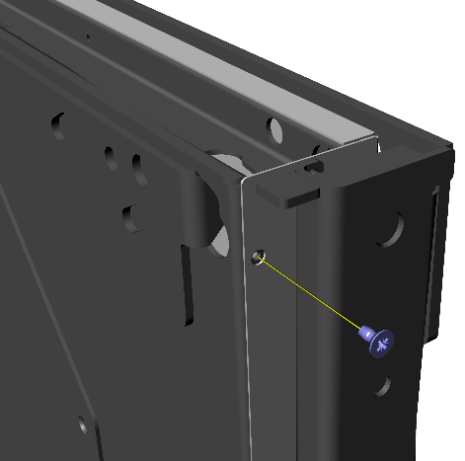
Mounting a BalanceBox®400 to a brick wall
Mount the wall frame cover by sliding it in at the top between the wall frame and the application frame.
Tighten the screws
NOTE: the cover is NOT included with the BalanceBox®400H

Slide 26
Mounting the Vesa bracket to the BalanceBox®400
Vesa bracket is specific for mounting flatscreens to the BalanceBox®
Metric hardware 4, 6 and 8 mm is included
Various holes for anti theft steel cable provided

Slide 27
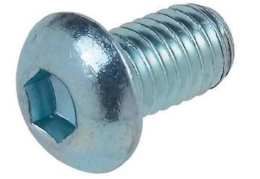
Mounting the Vesa bracket to the BalanceBox®400
Mount both horizontal plates to the BalanceBox® together with the BalanceBox® side covers.
Use 8 mm (12mm/½” length max!) hex. buttonhead screws and a 5mm alan key
M8 screws longer than 12mm/ ½” will cause BalanceBox® to block.
NOTE: Top and bottom are identical but mounted mirrored

Slide 28
Mounting the Vesa bracket to the BalanceBox®400
Mount both vertical profiles to the Flatscreen vesa connection
Use the metric 4, 6 or 8 mm screws provided (length 12mm/ ½”) or fasteners /length as specified by screen manufacturer.
NOTE: round holes are the top of the profiles

Slide 29
Mounting the Vesa bracket to the BalanceBox®400
Lift the screen, with the vertical profiles mounted, on to the horizontal plates mounted earlier on the BalanceBox®
Make sure hooks on the top should be engaged fully on both sides.
A two-man job!
NOTE: shift the screen
left/right to center it on
the BalanceBox®
2

Slide 30
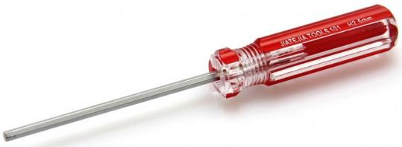
Mounting the Vesa bracket to the BalanceBox®400
Tighten the 6 mm buttonhead screws from the bottom to secure the screen on the BalanceBox®
Use a 4 mm alan key, preferably a screwdriver style tool as shown.

Slide 31
Setting the springs on a BalanceBox®400
Balancing:
Springs are always fully tightened for safety.
Use a drill driver and 13 mm socket, rotate counter clockwise (loosen)
Do 3 seconds left and 3 seconds right until the application starts to lower.
Now tighten until balanced

